Slide 1
Welcome

Slide 2



Microsoft solutions for Small Business
David Overton
Head of Small Business Technology – http://uksbsguy.com
Notes:
Please do a courtesy check of:
Gold, Certified, Registered Partners
Sales, Marketing, or Technical role
Midmarket or Small Business
Balance the pitch based on the audience
Spend more time on competencies if there are a high proportion of Registered in the room who will know little about them.
Job Role will indicate if we should allocate more time to demo, versus customer messages, versus marketing tools
Currently the deck is weighted at Mid Market – but when you know you have SB partners in the room be sure to acknowledge that while not all of the solution might be appropriate – at least the customer pains are similar

Slide 3
Agenda
Small Businesses factoids
Key questions and scenarios
A focus on IT management
Discussion
Next Steps

Slide 4
Managing IT focus
63% put data back and privacy as a top priority
7.6% of software spent on Anti-Virus
41% of small businesses admit running illegal software which jeopardize IT security
70% of small businesses that have a “catastrophic IT failure” never trade again
Buying solutions to these problems is much cheaper than imagined

Slide 5


Research Findings
Increased Business Efficiency is identified as a leading business issue for 7 of the top 10 growth industries in the mid market
Burlington Associates market study
“An average of 13 days per annum is lost by employees due to downtime.” This translates into 6% of staff costs, but more astounding was the fact that “up to 80% of time lost is spent in isolating the problem.”
Butler Group’s Technology Evaluation and
Comparison Report on Infrastructure Management
Notes:
Key messages:
Businesses really are getting worried about BE and it’s increasingly on their agenda. They will be interested in knowing how technology can deliver on these issues
The reality is that the 70/30 is very much in evidence and is a real drain on both IT resources and business profitability

Slide 6
Key IT questions to ask yourself
What stage is your business at?
Do you need to manage your customers more effectively?
Do you want your business to be perceived professionally and to stand-out more?
Is data and computer security a concern?
Do you want to work out and about more?
Will you be using it at home as well?
Notes:
Burn this into your memories!!! Take this away with you!!!
If your customers say yes to any of these, then Office 2007 and Windows Vista is the right product for them
Data – backup, bitlocker, Hard drive problem detection

Slide 7
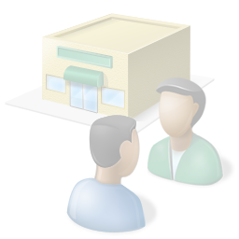
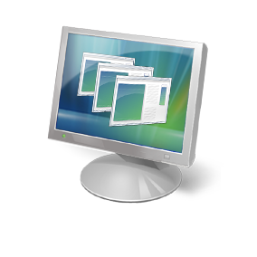
“What do you want
your computers to do
for you?”

Slide 8


IT Usage Survey - Results
?
high
time drain
looking for info
staff management
managing the workplace
low priority

Slide 9


IT Usage Survey - Results
Security
- biggest
time drain

Slide 10
IT Usage Survey - Results
50% don’t backup
daily

Slide 11
IT Usage Survey - Results
40% don’t
use a firewall

Slide 12

IT Usage Survey - Results
breaches cost
£10,000 and
time

Slide 13










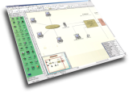
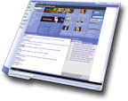


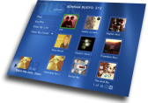
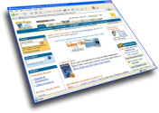








Information-Driven
Share,
Communicate
Strategize,
Decide
See,
Imagine
Execute,
Adapt
Find, Relate, Act
Information Access
Digital Information Explosion

Slide 14
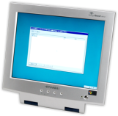


Generic Architecture Diagram
Devices that do work connected or disconnected
Clients
Technology that you own that sits “at the centre” delivering value for your business
Servers
Services that you use “in the cloud” – either free or paid for, however you don’t own it
Services

Slide 15






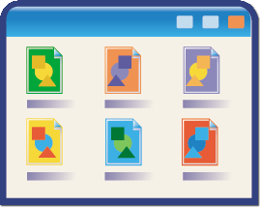
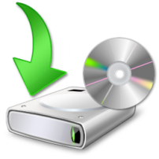

What do you want to do?
 | Professional e-mail E-mail via many access points
 | Personal, business and shared calendars Ability for others to see diary and manage / request time
 | Find information no matter where it is filed Use all information that we have access to
 | Build compelling documents and brochures Deliver in house what only used to be available via an agency
 | Have full access to your customer information anywhere Manages and share the sales and support
 | Run the best applications to help you run your business There are more Line of Business (LOB) applications on Windows
 | Keep all your business information safe and easy to recover Stop “nasty” things happening to your PCs

Slide 16




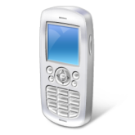

The starter Small Business
In the Digital Home
Home Office
Internet
Notes:
Elyn—
Graphics will show the before scenario:
Many users each with a printer, fax machine and Internet connection.
After scenario will show:
Many users sharing Internet, printers, fax machines (will also show faxing occurring directly from PC).

Slide 17







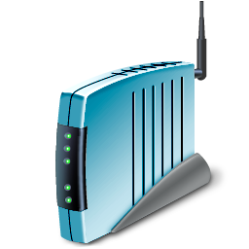
The Growing Small Business
In the Digital Home
Mobile
The Office
Internet
Other Businesses
Notes:
Elyn—
Graphics will show the before scenario:
Many users each with a printer, fax machine and Internet connection.
After scenario will show:
Many users sharing Internet, printers, fax machines (will also show faxing occurring directly from PC).

Slide 18

The Expanded Small Business
In the Digital Home
Mobile
The Office
Internet
Other Businesses
Notes:
Elyn—
Graphics will show the before scenario:
Many users each with a printer, fax machine and Internet connection.
After scenario will show:
Many users sharing Internet, printers, fax machines (will also show faxing occurring directly from PC).

Slide 19
Generic Architecture Diagram
Devices that do work connected or disconnected
Clients
Technology that you own that sits “at the centre” delivering value for your business
Servers
Services that you use “in the cloud” – either free or paid for, however you don’t own it
Services

Slide 20

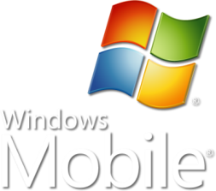






The Technologies for Today
Clients
Servers
Services
Notes:
Need to talk baout costings and about BT IT Manager & MS Finance with partner

Slide 21











“Upgrading has made a huge difference,” explains Davidson. “Our systems are much better-they’re easier to use and there are less crashes, saving a lot of time. It’s a solid platform and I’d hate to go back to how it was before.”
The company server was frequently crashing.
Although there were back ups this was wasting valuable time.
The company wanted to install systems that linked the phone to IT.
J. Duncan Davidson upgraded to Microsoft® Windows® Small Business Server 2003.
The company now has a more stable backbone that supports growth.
Reliable systems
Remote e-mail/file access
Shared diaries and calendars
Supports customer relationship management system
Server able to be linked to phones
Notes:
Recommended that you read the full case study at: http://www.microsoft.com/resources/casestudies/CaseStudy.asp?CaseStudyID=16863
Accountancy firm J. Duncan Davidson was facing an increasing workload and decreasing value from its IT infrastructure. The systems it had were increasingly unreliable, leading to staff having to spend valuable time maintaining them. By upgrading to Microsoft® Windows® Small Business Server 2003, the practice has a reliable system that has enabled it to install broadband, work from home and install a customer relationship management system. In total it has made the company 10 percent more efficient.
Situation
J. Duncan Davidson (JDD) is a firm of chartered accountants based in Aberdeen. It employs eight people in total and has a wide variety of clients. According to Duncan Davidson, Proprietor of JDD, “We have all kinds of clients from sole traders through to medium sized limited companies. We also have a fair number of private individuals who use our services.”
The business relies on technology to serve its clients. “We use it extensively,” said Davidson. “We all have PCs in the office. These are networked and we then use Iris Software for accounts production and tax returns. We also have law and accountancy databases running off the server. There is very little in our job that doesn’t involve a computer these days.”
However, the company was facing increasingly unreliable systems. “We faced frequent crashes that lost data. We did have a back up but this meant I had to spend valuable time restoring data from old back up tapes. This was taking up too much time so we needed to do something about it,” explains Davidson.
JDD made the decision to upgrade the company’s IT systems. Davidson says, “As well as fixing an increasingly unreliable infrastructure, we decided to install systems that would enable us to install broadband-something we weren’t able to do before. We also wanted a solution that would enable us to integrate the phone systems and computers.”

Slide 22





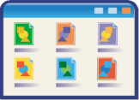
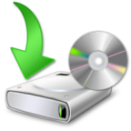



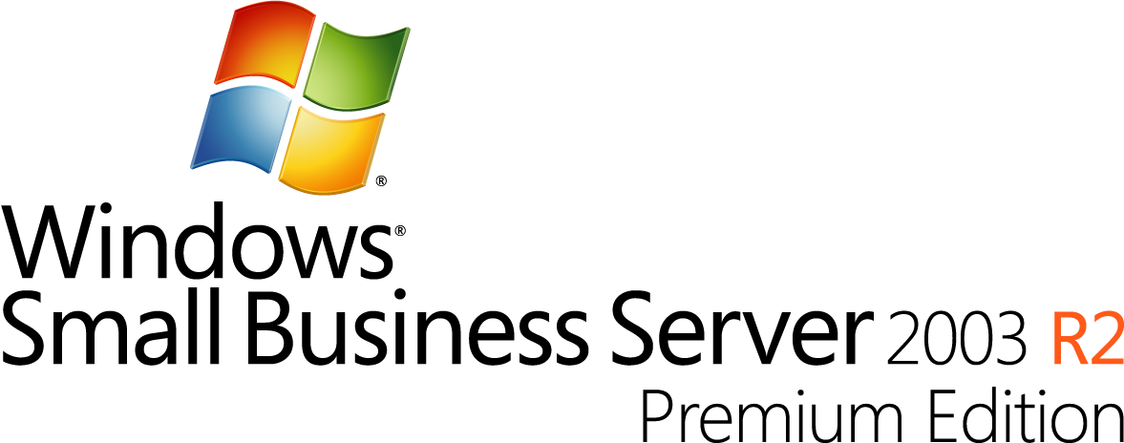
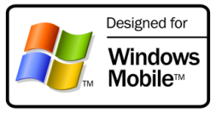

Small Business Solutions
Data backup and security
Backup your files or machine automatically
Encrypt files or your hard disk for added protection
Understand what your IT is doing and how to change things
Roll back to previous versions of a document simply
Manage your system patching
Stop spam and junk e-mail from impacting your business
Protect your documents from “leaking” information or being viewed by the wrong people
Remove the risk from Phishing Mails

Slide 23

Products depending on needs
 | Starter business |  | Growing |  | Expanding
Maybe
One of
Yes

Slide 24
Managing IT Principles
Use Anti-virus / Anti-spyware
Have an IT Strategy
Patch Systems
Use firewalls
Use qualified consultants
Ask why it happened

Slide 25
Areas for discussion or demo
PCs
Systems management and heath checks
Security and Backup
Anti- virus / Online checks
Servers
Centralised sharing and backups
Remote access to systems
Policy based access
Hosted solutions
Managed e-mail, calendars and contacts
Subscription hosted solutions
Mobile
Keeping safe information safe if device is lost

Slide 26
How to Buy
New Computer
For the best value, ask for Windows Vista Business and Office Small Business Edition on a new computer
Upgrade on existing computer
If you are looking to upgrade to Windows Vista Business or Office 2007, we recommend you check your computer specification to ensure it is Vista-compatible. Both products can be purchased through quality retailers
Upgrading 5 or more computers
If you want to upgrade 5 or more existing computers, consider a volume licensing option such as Open Value Subscription in order to get volume discounts

Slide 27
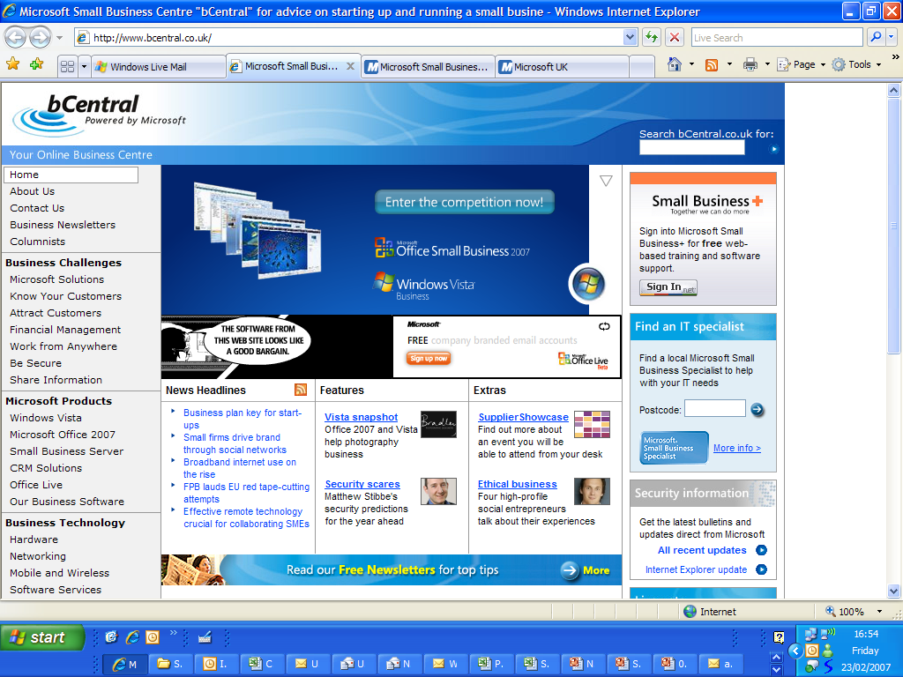

Slide 28

Getting started
Microsoft partners
  Small Business Specialists
Microsoft Websites
  bCentral – http://www.bcentral.co.uk
  Small Business + - http://www.microsoft.com/uk/smallbusinessplus
  Office Templates sites – http://www.microsoft.com/office/templates
  Office Live – http://www.officelive.co.uk
  David’s blog http://uksbsguy.com

Slide 29

© 2006 Microsoft Corporation. All rights reserved.
This presentation is for informational purposes only. Microsoft makes no warranties, express or implied, in this summary.
Notes:
29

