Slide 1

SBS 2008 –
One year on
David Overton http://davidoverton.com

Slide 2
Agenda
Introduction
“Non-announcements” and announcements
Brief overview of SBS 2008
SBS 2008 with Hyper-V R2
Moving from SBS 2003 to SBS 2008

Slide 3
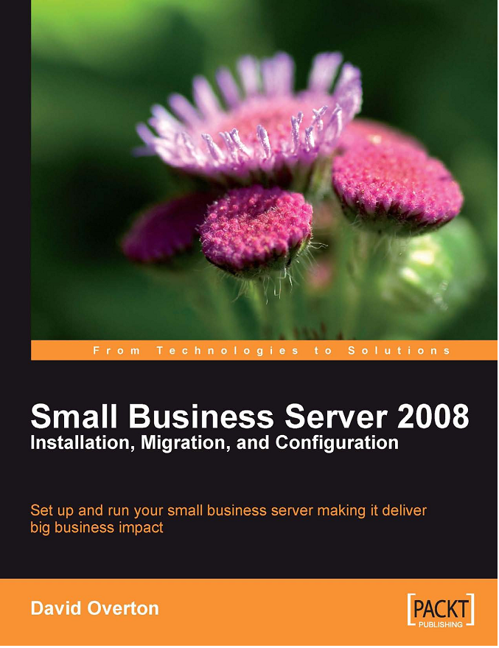
David Overton
Worked with SBS since 2003
Was “Head of Technology for Small Business” at Microsoft
Still running SBS 2008
Wrote a book!!
Love
  Technology
  Quality partners
  Sailing
  Star Wars (oh well)
http://davidoverton.com

Slide 4
Announcements
No announcements on SBS 2008 R2
We are continuing with the development of the SBS product line, but the current product is still very young (less than a year old)
SBS 2008 works just fine with Windows 7

Slide 5
SBS 2008

Slide 6
What is SBS 2008?
Affordable, integrated solution designed for small businesses.
Priced to deliver a comprehensive network at an affordable price.
Protects your business data from accidental deletion or disaster
Enable secure cross-business access to information, either in the office or while mobile
Updates and protects all your computers

Slide 7
What technologies are in SBS 2008
Windows Server 2008
Exchange 2007
Windows SharePoint Services
Windows Software Update Services
SBS 2008 Console
SBS 2008 Remote access tools

Slide 8
SBS 2008 and Hyper-V

Slide 9
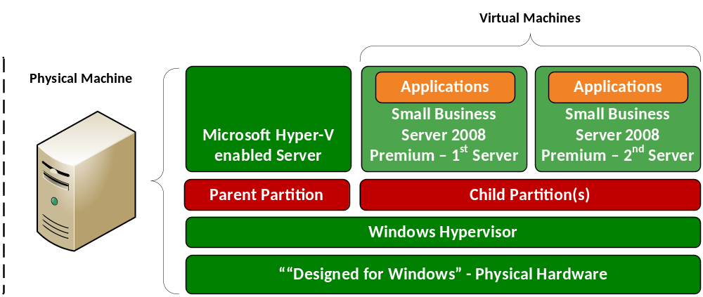
Scenario 1 – Windows Small Business Server 2008 Virtualized
Customer Scenario: I want to virtualize all of SBS on one physical system
Some SBS features will work differently (e.g. backup, Fax)
The same minimum hardware requirements and configuration best practices will apply in a virtual environment.

Slide 10
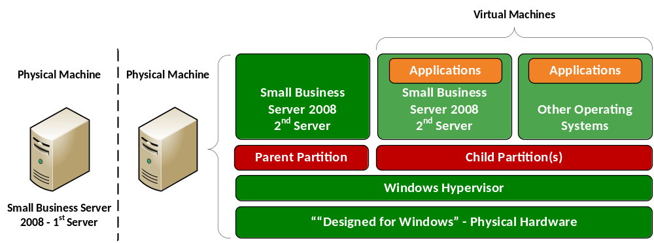
Scenario 2 – Windows Small Business Server 2008 Premium Edition Server Virtualized
Customer Scenario: I want to virtualize lots of old h/w on one platform
This scenario is the natural extension of the SBS 2008 Premium SKU in general.
The Hyper-V parent partition adds some overhead that needs to be taken into account. Not much but still… This overhead is Hyper-V generic and not SBS specific.

Slide 11
Moving from to SBS 2008

Slide 12
What is the process to move to SBS 2008
Clean install
  Install and configure SBS 2008 on the server
  Create the users on SBS 2008
  Visit each PC and run the connect computer wizard
  All user files and settings are migrated to the
Migrating
  Ensure the existing domain in healthy
  Change network configuration if necessary
  Install SBS 2008 in migration mode
  Migrate e-mail, user data, shared data, Companyweb and database applications
  Decommission SBS 2008

Slide 13
Preparation Process (part 1)
Plan the migration process including how you will move 3rd party applications
Communicate plan and impact to users and get agreement on impact
Checking the health of SBS 2003 Active Directory
Backup existing server
Change network configuration to match SBS 2008 design requirements
Update software on SBS 2003
Change Active Directory functionality level

Slide 14
Preparation Process (part 2)
Confirm SBS 2003 is currently configured at best practice levels
Remove unnecessary e-mail from Exchange
Check permissions are set to allow a migration
Prepare SBS 2003 Time Synchronisation
Run the migration tool on SBS 2003
Prepare migration of line-of-business applications
Complete the answer file for SBS 2008 migration

Slide 15

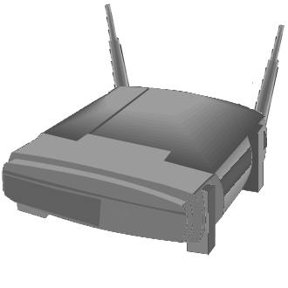


Reconfigure network
Internet
Internet connection via modem
Firewall provide by separate device or included in router or modem
Local LAN
Network router
(can provide
wireless too)
NIC 1
SBS 2003/8
Desktops and Laptops

Slide 16
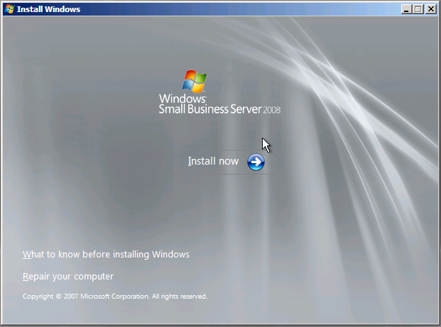
Install SBS 2008
Install SBS 2008
Configure basic network settings
Get system updates
Confirm your company information
Create an administration account for new systems
Name the server
Install anti-malware tools
Resolving installation issues

Slide 17
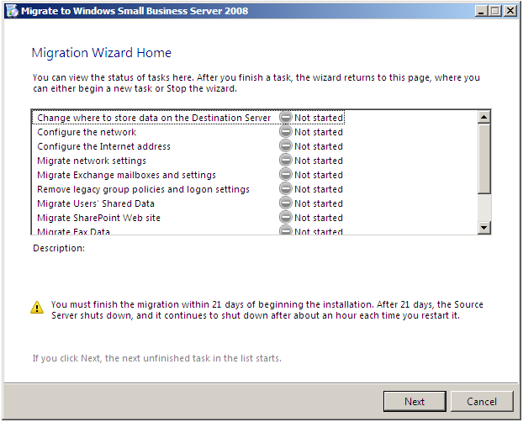
Easy Migration?

Slide 18
Start Migration Process
Starting the Migration Wizard
Initially configuring the SBS 2008 network
Configure Internet Access
Migrate the SBS 2003 network settings across
Cleaning up the group policy settings
Get users to remove unwanted e-mail, empty deleted items folder

Slide 19
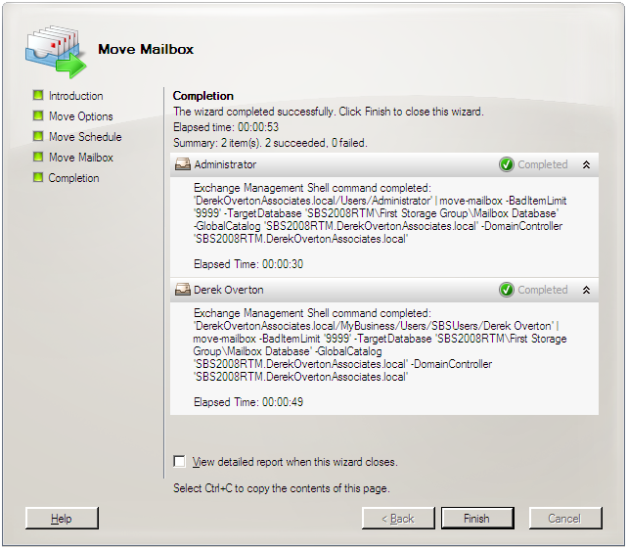
Moving e-mail – it just takes time

Slide 20
Migrating SharePoint
On the SBS 2003 server
  Prepare and check CompanyWeb on SBS 2003 for migration
  Backup the database
  Copy the files to a removable device or create a network share
On the SBS 2008 server
  Configure the DNS for the migrated site
  Import the data
  Create the OldCompanyWeb site
  Tidy up the site

Slide 21
Migrating User Data
Migrating file shares
Migrating the Fax data
Migrate users and Groups
Migrate LOB applications
Finish the Migration

Slide 22
Securing the Server
Configuring the firewall ports
Configuring and testing the backups
Configuring anti-malware

Slide 23
Managing Users and Computers
Managing roles
Adding Users
Managing users storage
Adding computers to the network
Ensuring computers are up to date with updates

Slide 24
Management Tools
Windows SBS Console
Windows SBS Console (Advanced Mode)
Windows SBS Native Tools Management
Exchange Management Shell
Command Prompt run as Administrator

Slide 25
Management tasks
Daily maintenance check via reports
Maintenance areas
  Security
  Backup and Recovery
  Forefront Updates
  Storage
  Event Log Messages

Slide 26


Thank-you
Microsoft Learning
www.microsoft.com/learning
Springboard Series
www.microsoft.com/springboard
My Blog and ability to buy book
  uksbsguy.com or
  davidoverton.com

