Slide 1
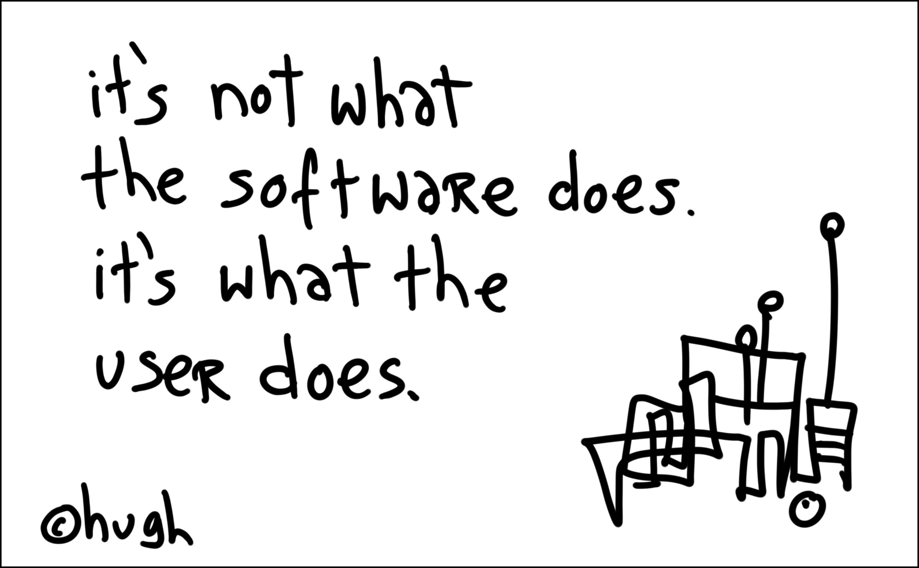
http://www.gapingvoid.com
David Overton – Transforming Businesses for the future
http://uksbsguy.com doverton@microsoft.com
Microsoft Ltd

Slide 2
Agenda
Where is IT going
Where are small businesses
Where are Microsoft going
How to engage

Slide 3

The 1st IT Support Call

Slide 4


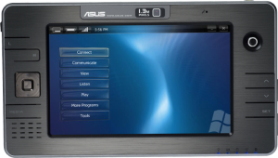
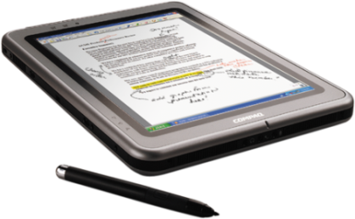


Megatrends
Broadband,
Wireless, Mobility,
Form Factors
Performance of Hardware
Digitization
of the Economy
Software Breakthroughs

Slide 5








Evolution of Work
Traditional Work
Home & Work
The New World of Work

Slide 6

Digital Workstyle: Basics
Office productivity suite
Email
Single directory
Corporate intranet
Portable PCs for mobile workers
Transactional website

Slide 7
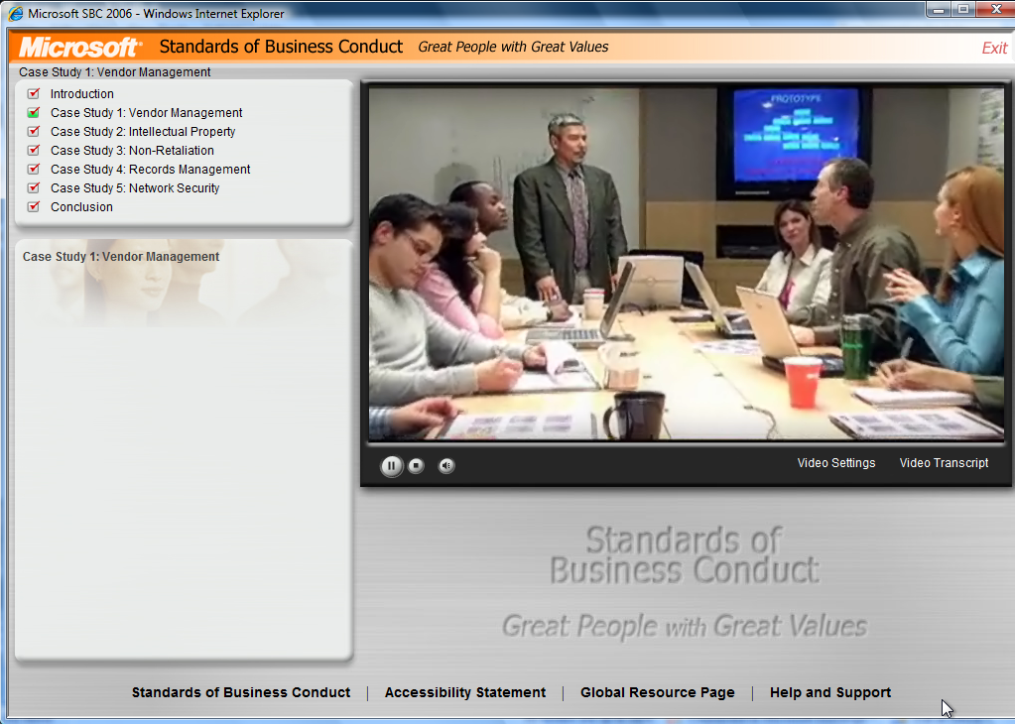
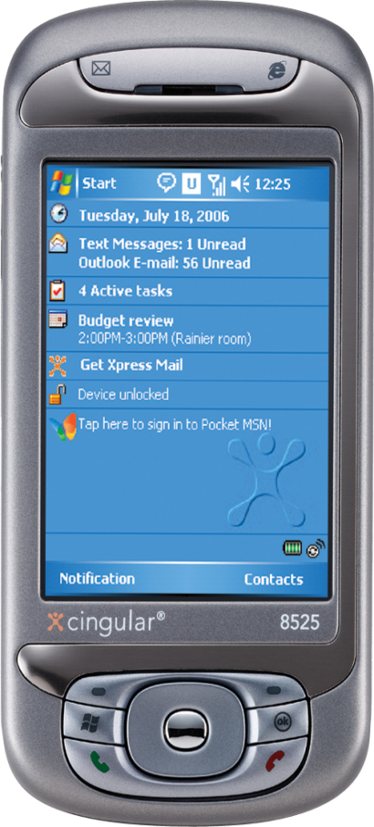
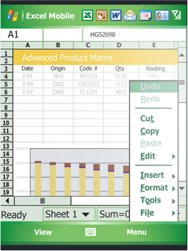
Digital Workstyle: Empowered
Online video training
HR self service
Analysis & metrics
Surveys & workflow
Sales information
in pivot form
Collaborative
screen-sharing
Business information on mobile phones

Slide 8

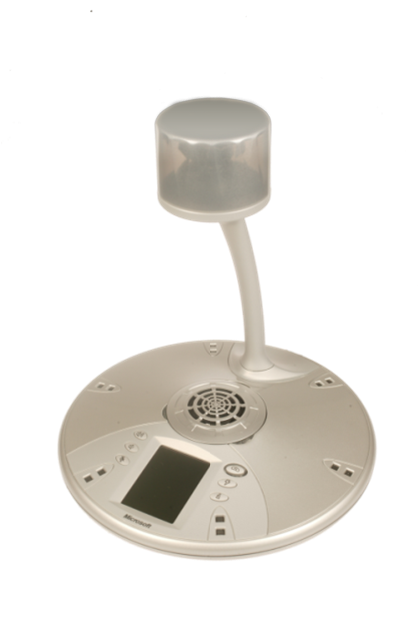

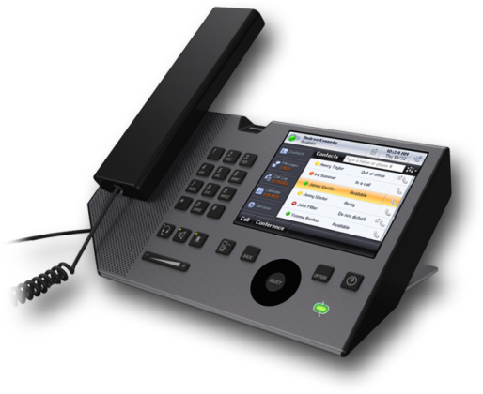
Digital Workstyle: Advanced
Rights managed documents
VOIP & Unified Communications replacing PBX
Digitized meetings including Roundtable
Rich models for forecasting
Tablet computing
Video channel for community involvement

Slide 9






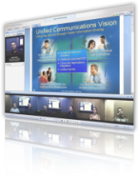
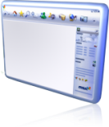


Communications Transformation
Network-Driven Communications
1837
1876
1984
2007
Software-Driven Communications

Slide 10
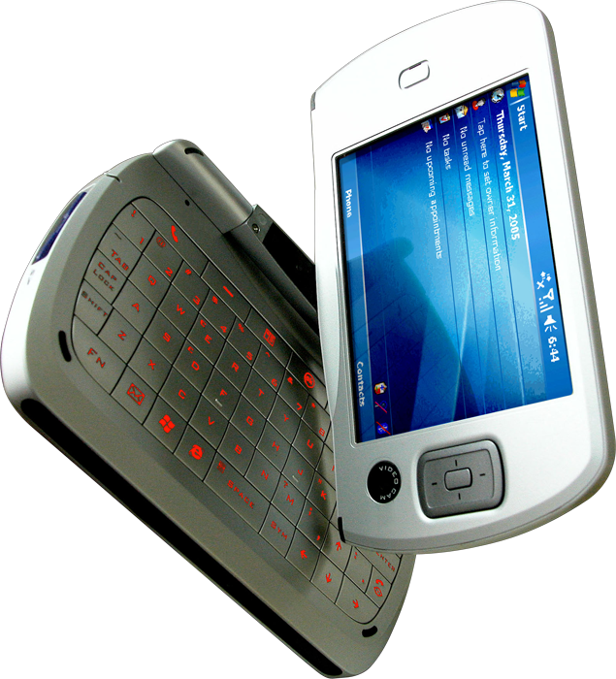
Mobility Advances
Business email & calendar
Business documents
Camera
Music and video
Reading & browsing
Speech input
Location information
Payment

Slide 11
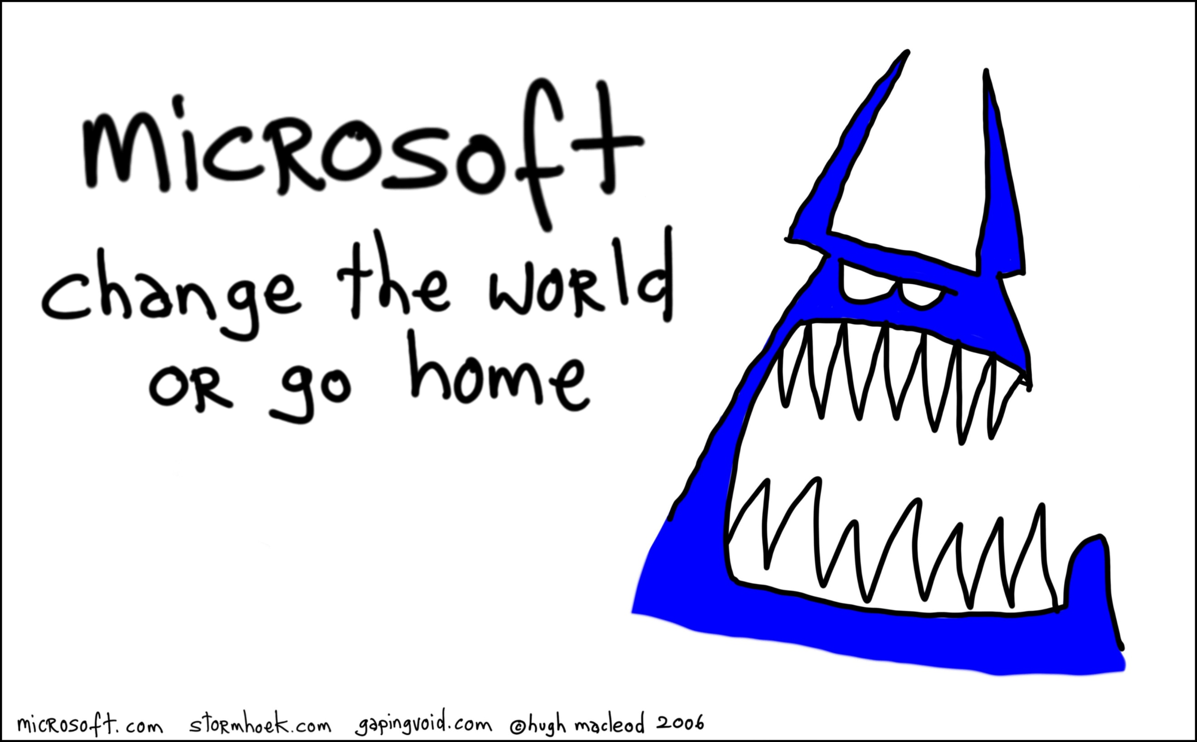

Slide 12

Looking Ahead
Digital workstyle improving rapidly
Digital media revolution underway
Communication, collaboration, reading, TV, advertising
changed radically
Software improvements including speech and vision will accelerate these trends

Slide 13

UK Small Businesses
"clear evidence of market failure" around IT adoption and that "the UK could be in danger of being left behind“
“There is a long and stubborn tail of non‐adopters. The main barriers for non adopters are a lack perceived relevance or benefits, skills shortages and costs”
63% of small businesses using technology believe that their technology investment increases productivity
47% say that it has had a direct and positive impact on profitability
41% of small firms link their technology investment with increased turnover.

Slide 14




UK Small Businesses
Over 40% do not have a basic firewall
Over 50% do not patch their PCs
Only 20% of businesses are using IT for CRM yet the majority of small businesses claim that it was their personalised approach to customer service that set them apart from their competitors.

Slide 15
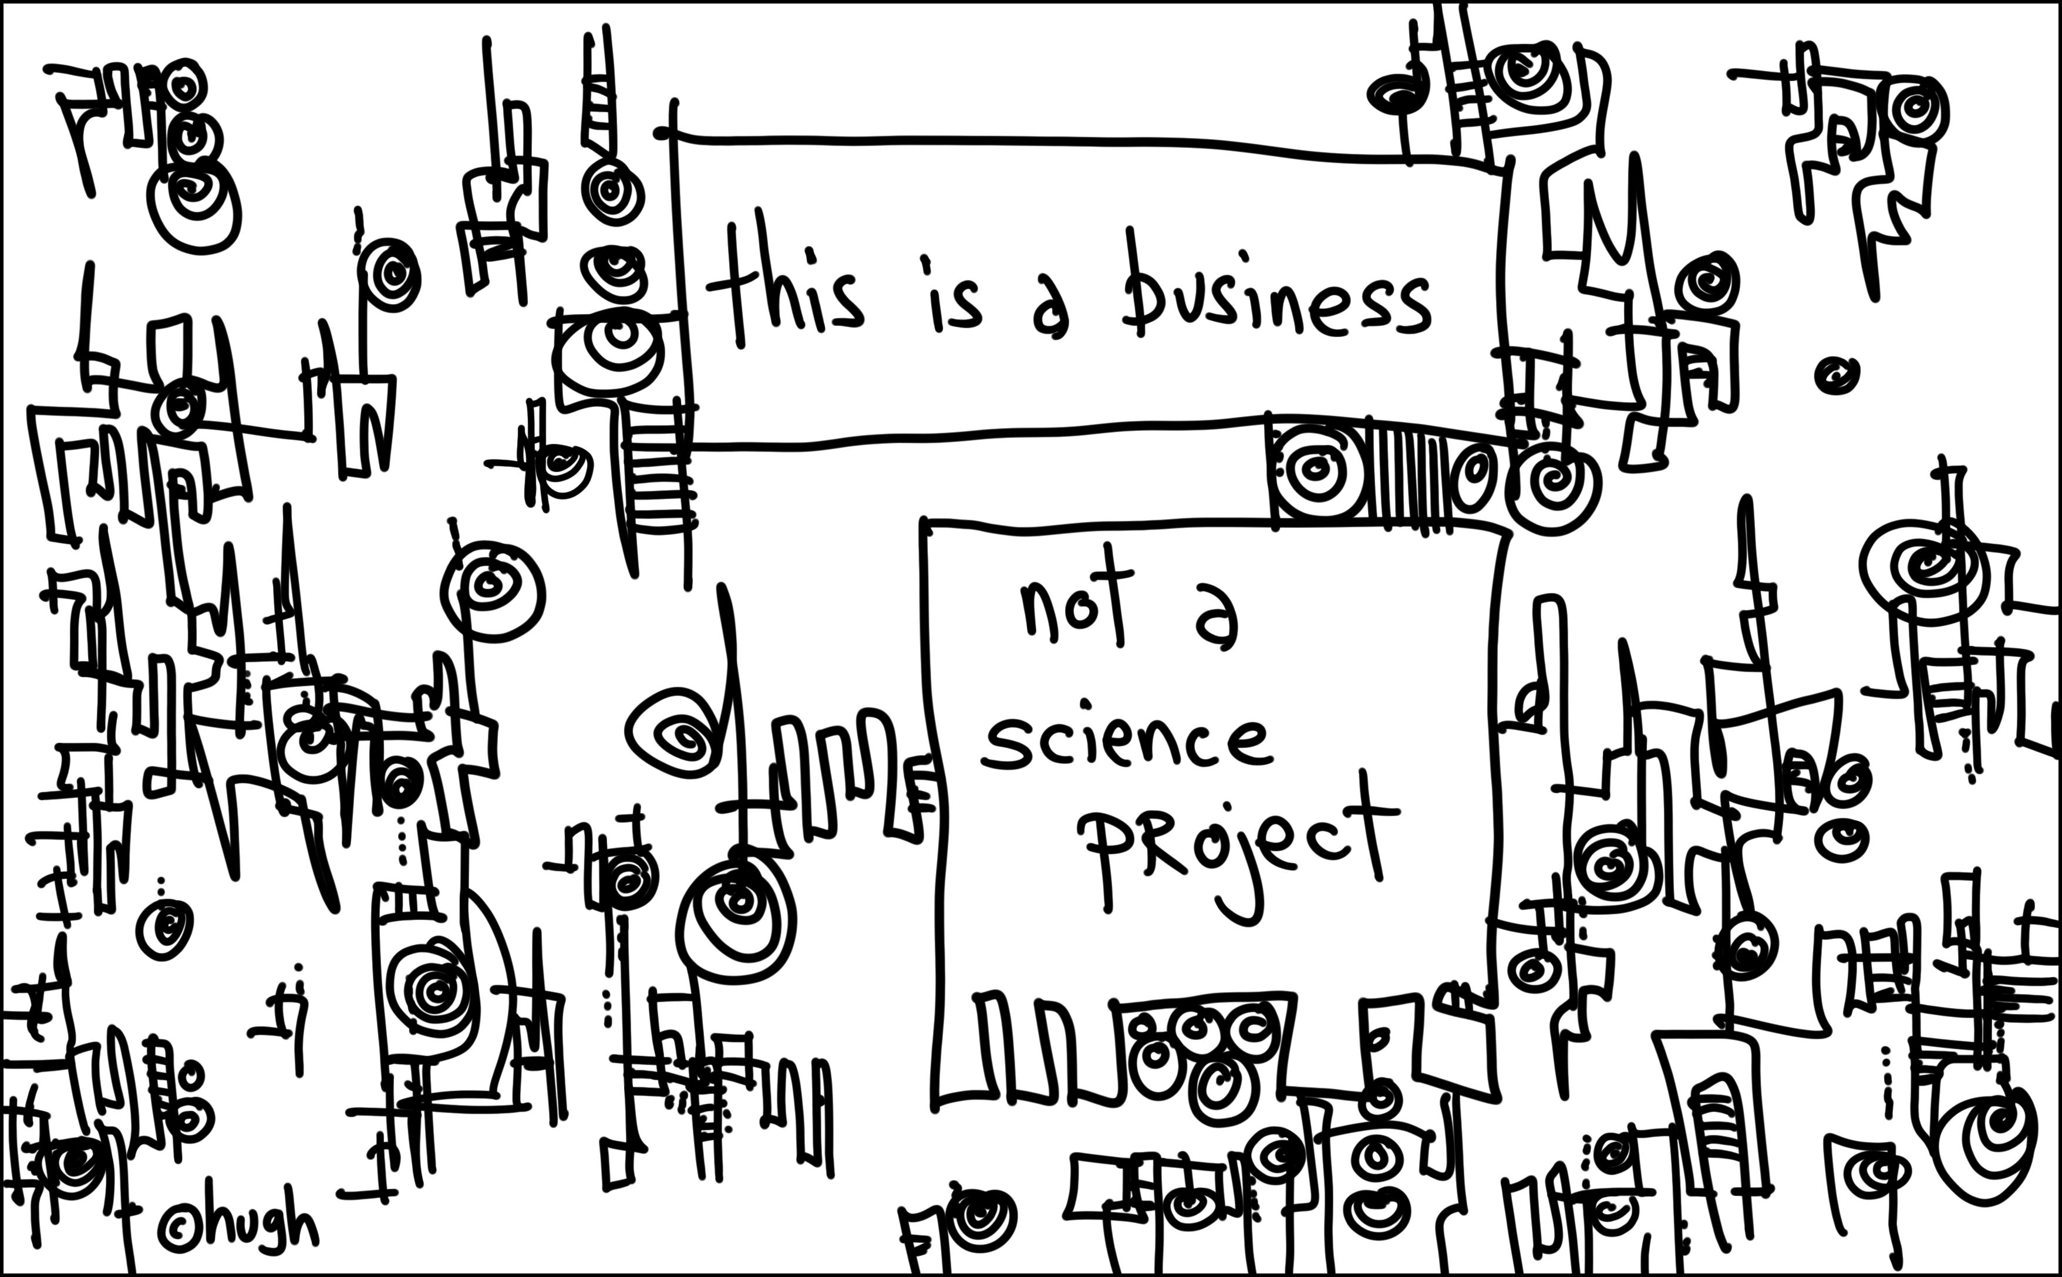

Slide 16
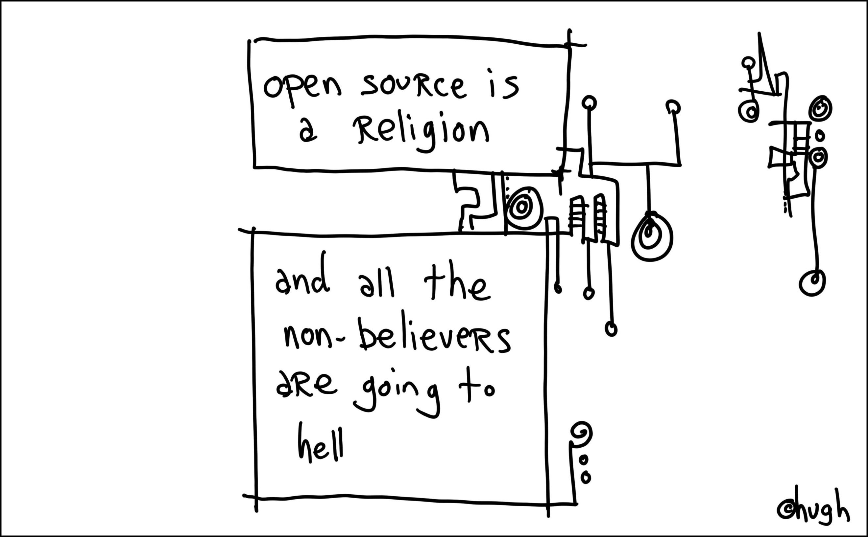

Slide 17






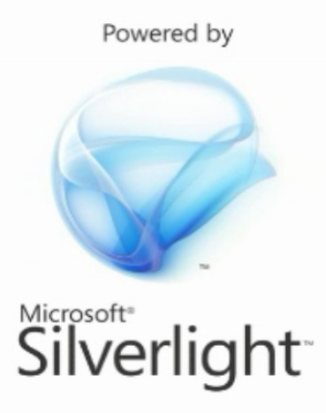

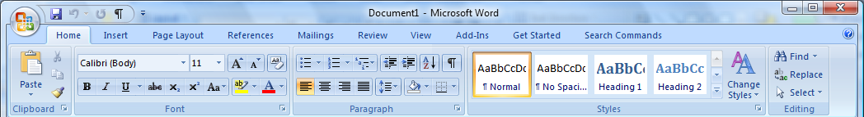
New areas and old friends
Popfly, Office Live, Vista, Office Ribbon, RSS, Blogs, BT Apps Platforms

Slide 18
Demo

Slide 19





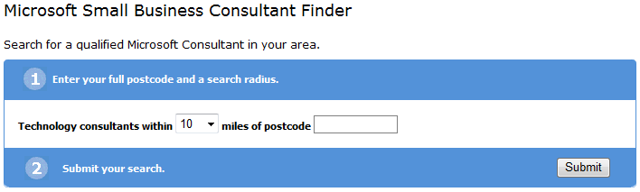
How to engage
For Advisors and Business
  bCentral consultant search
  SBSC partners
MS Partner
  MS Partner programs
  Becoming a SBSC partner

Slide 20

Thank You

Slide 21

http://uksbsguy.com

Slide 22

© 2007 Microsoft Corporation. All rights reserved. Microsoft, Windows, Windows Vista and other product names are or may be registered trademarks and/or trademarks in the U.S. and/or other countries.
The information herein is for informational purposes only and represents the current view of Microsoft Corporation as of the date of this presentation. Because Microsoft must respond to changing market conditions, it should not be interpreted to be a commitment on the part of Microsoft, and Microsoft cannot guarantee the accuracy of any information provided after the date of this presentation.
MICROSOFT MAKES NO WARRANTIES, EXPRESS, IMPLIED OR STATUTORY, AS TO THE INFORMATION IN THIS PRESENTATION.

