Slide 1


Slide 2
Small Business Server and Windows SharePoint Services
David Overton
http://UKSBSGUY.com

Slide 3
Agenda
Key capabilities around web based teaming working
Management of Windows SharePoint Services (WSS)
Windows SharePoint Services v3.0 on Small Business Server
Questions

Slide 4
Web based teaming
Need
  To share information and keep everyone updated
  Maintain a history of document changes
  Workspaces based on projects, documents or meetings
  To have shared calendars that are web accessible
  To manage surveys to collect information and process
  A repository for Infopath form and data
IDC Proof Points

Slide 5
Document Management
Place to store files
Search for files you have access to
Secure files for closed groups
Automatic version control
Check-in & Check-out (optional)
Place to work as a team on a document
Alert on changes
E.g.
  Policy & regional document stores
  Press releases

Slide 6
Calendars and Meetings
SharePoint Calendars are for groups or resources (not personal)
Calendars can be viewed on web or in Outlook
Meetings can have a workplace
  Actions, attendees, agenda, documents
Alerts on changes
E.g.
  Event & regional calendars
  Regional Meetings

Slide 7
Discussions
Have recorded discussions with history
Discuss a document or file
Search discussions
Be alerted on discussion topics

Slide 8
Lists
Easy list usage and creation
Includes :
  Contacts
  Calendars
  Announcements
  News
  URL links
Has the ability to time-out
Can be edited in an Excel-like form
E.g.
  Ad-hoc contacts for committee meeting
  FAQ’s
  Interesting facts

Slide 9
Surveys
Questionnaire for feedback
Easy to respond to
Can be associated with documents
Easy to view results
Results can be processed in Excel for detailed analysis
E.g.
  Regional survey to help prepare for the AGM by soliciting information from regions

Slide 10
Sub-sites
Site specialised for task, group or project
Looks like any other SharePoint site
Can be easily created through process with IT
E.g.
  Special site for Executive

Slide 11
Frontpage customisation
Capabilities of web based editing
Ability to work with Office Web Components
Ability to work with Data enabled controls
Ability for web part connections to link across pages
Easy

Slide 12
WSS DEMO
Moving items on the screen
Modifying the Announcements
Document workspaces from Outlook
Opening a shared document
Document alerts
Accessing documents via file shares
Shared Calendar (holiday calendar)
Meeting workspaces
Create a customer list using spreadsheet import
Show data modification using form and Excel datagrid
Build a customer satisfaction survey to be completed by staff
Importing a site template

Slide 13
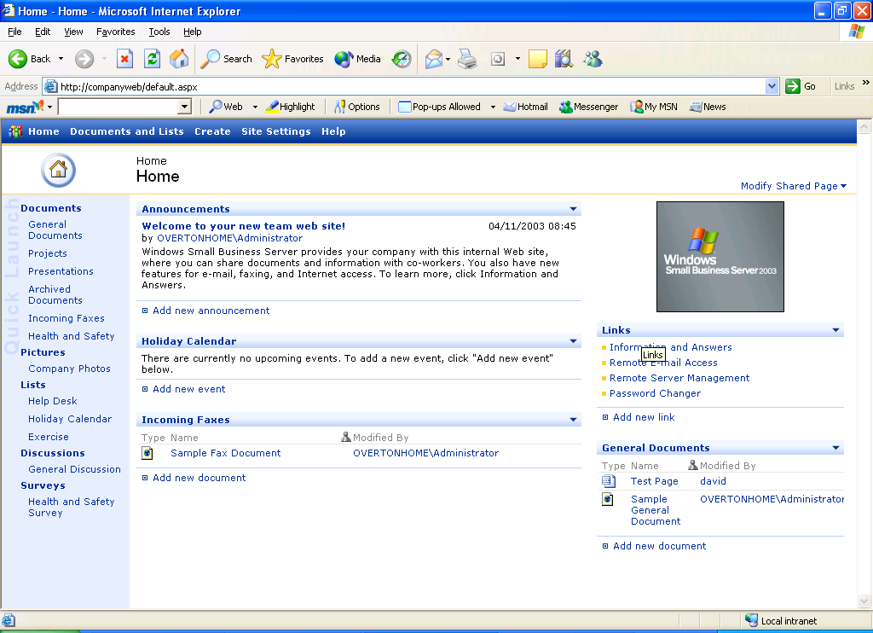

Slide 14
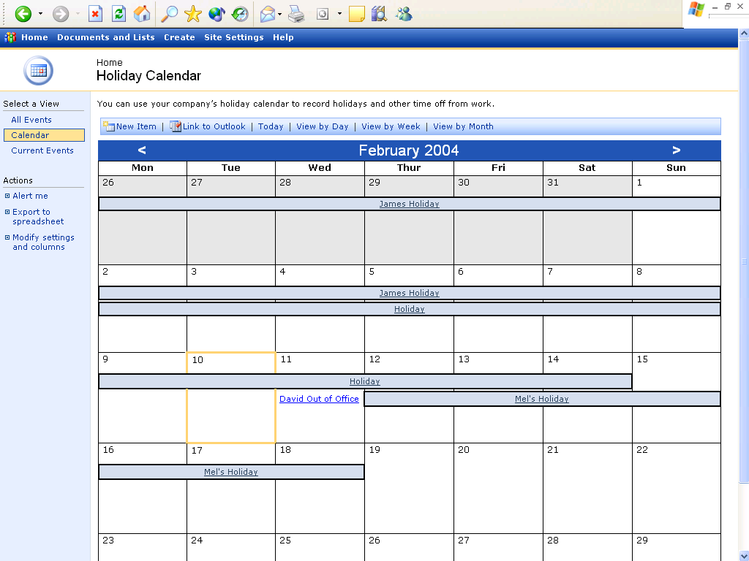

Slide 15
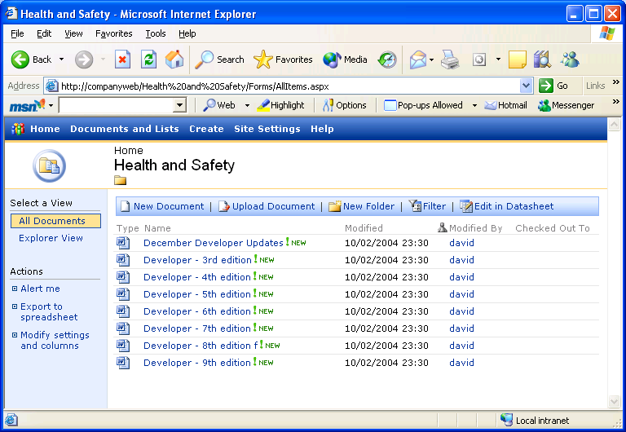

Slide 16
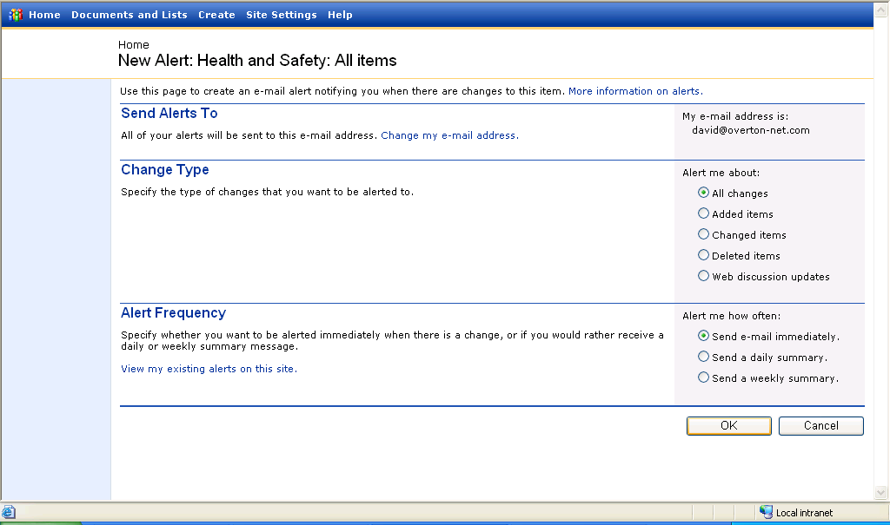

Slide 17
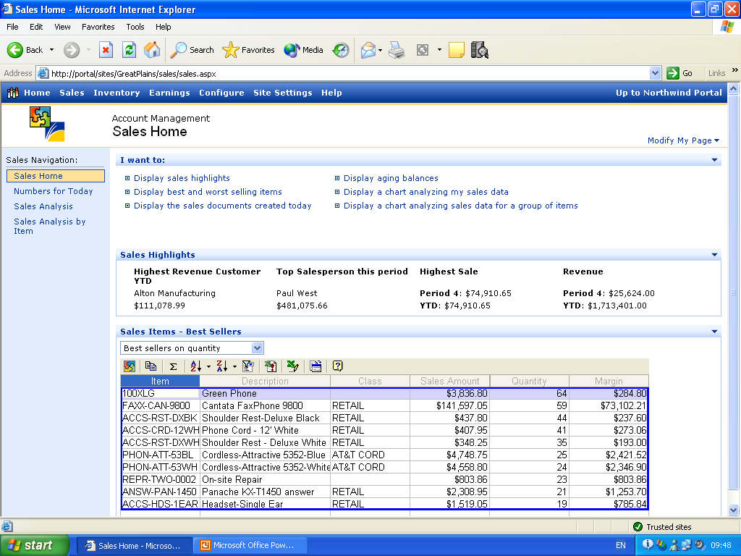
Notes:
I could also create more customised sites that integrate my ERP systems into the portal.
This example show how a customer using GreatPlains can integration many aspects of their business data into the intranet.

Slide 18
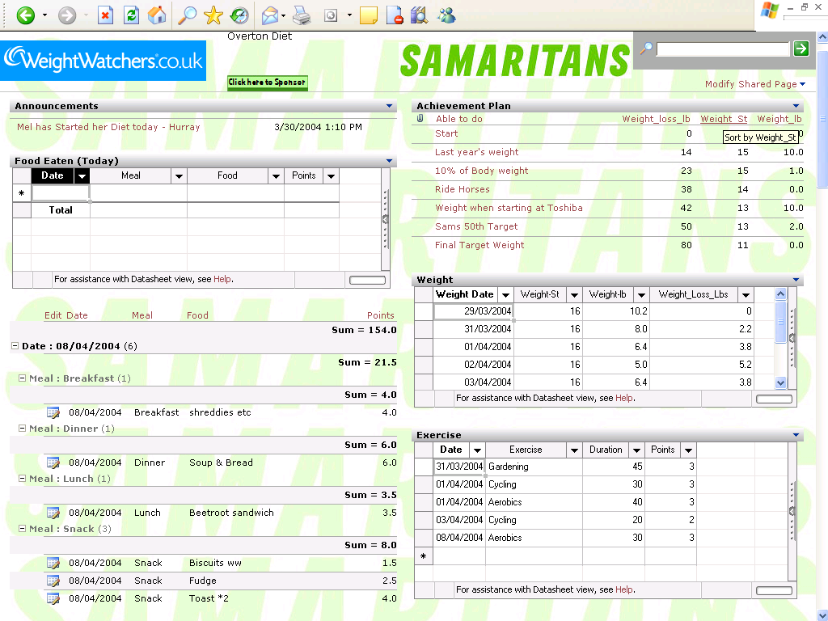

Slide 19
Enhancements to WSS
Office web parts - http://www.microsoft.com/downloads/details.aspx?familyid=38be67a5-2056-46a1-84b1-337ffb549c5c&displaylang=en
Samples and information at http://www.sharepointcustomization.com/wss/articles.htm
Enable Office 2007 support
http://uksbsguy.com/blogs/doverton/archive/2007/03/13/how-to-get-companyweb-windows-sharepoint-services-v2-to-work-with-office-2007.aspx

Slide 20
Managing SharePoint Services
Understand that all data is stored in SQL database
Backup and restore of WSS using admin command line
http://www.microsoft.com/smallbusiness/support/articles/backup_restore_sbs2003.mspx#EPDAE
  Backup - Stsadm.exe -o backup
  Create new site - Stsadm.exe -o createsiteinnewdb
  Restore - Stsadm.exe -o restore
Recycle bin support
http://mindsharpblogs.com/Todd/archive/2005/10/06/719.aspx

Slide 21
Install Windows SharePoint Services V3.0
Use the force (well, the whitepaper):
  http://go.microsoft.com/fwlink/?LinkId=77404
    Backup – always!!
    Install Microsoft .NET Framework 3.0.
    Install Windows SharePoint Services 3.0.
    Configure Windows SharePoint Services Products and Technologies.
    Create a new intranet site using Windows SharePoint Services 3.0.
    Delete the Windows SharePoint Services 3.0 default Web site.
    Start the default Web site and the Windows SharePoint Services 2.0 http://companyweb Web site.

Slide 22
Windows SharePoint Services v3.0 on SBS 2003 – what you can do
Comparison at http://www.microsoft.com/technet/windowsserver/sharepoint/techref/versions.mspx
Everything in WSS v3 – improved, plus:
  Recycle Bin
  Blogs
  Wikis
  Office 2007 native integration (eg 2 way calendars)
  People information
  Offline working
  RSS feeds from lists
  Finer access controls
  Workflow
  Search without SQL Server

Slide 23
Windows SharePoint Services v3.0 on SBS 2003 – what you can’t do
Replace http://companyweb (you can NOT replace)
The integration of incoming e-mail with Windows SharePoint Services 3.0 does not work
If you moved the Windows SharePoint Services 2.0 databases from WMSDE to SQL Server 2000 or to SQL Server 2005, Windows SharePoint Services 3.0 Search does not function after you install Windows SharePoint Services 3.0.
Workarounds:
http://msmvps.com/blogs/cgross/archive/2007/01/25/companyweb-sharepoint-v3-part-1.aspx - external access to v3 site & renaming companyweb
http://www.mrict.co.uk/resources/incoming_email_for_wss_3_and_sbs.asp - incoming e-mail

Slide 24
Questions

Slide 25
Key Resources
http://uksbsguy.com
http://www.microsoft.com/sbs
http://blogs.technet.com/sbs
http://www.sharepointcustomization.com
Blogs:
  http://msmvps.com/blogs/cgross/archive/2007/01/25/companyweb-sharepoint-v3-part-1.aspx
  http://www.mrict.co.uk/resources/incoming_email_for_wss_3_and_sbs.asp

Slide 26


