Slide 1


Windows Small Business Server 2003 R2 OPK
Sven Gruenitz
OEM Systems Engineer
Microsoft Corporation
sven.gruenitz@microsoft.com

Slide 2

In this session you will learn
  how to preinstall Windows SBS 2003 R2 using the OPK
  how to add mass storage & NIC drivers
  how to avoid common issues
  how to use Windows PE 2.0 (Vista) to preinstall

Slide 3

  How to preinstall
  Windows SBS 2003 R2
  using the OPK

Slide 4
    Phase 1:
    The preinstallation phase
During this phase, the operating system is preinstalled.
Using the Windows Preinstallation Environment (WinPE)
branding information and 3rd party drivers or applications can be
preinstalled during the operating system installation process.
This method requires that you
  create an SBS configuration set
  build the $OEM$ file structure
  use Setup Manager in OEM mode to add branding
  information, change any default settings, and add 3rd party
  drivers and applications.
Phase 1 is performed on the technician computer.

Slide 5
    Phase 2:
    Installing SBS components
During this phase, Windows Small Business Server
2003 R2 components are manually installed on the
master computer.
You must use the /OEM switch from a command prompt:
C:\SBS2003\CD1\SETUP\I386\SETUP.EXE /OEM
This process is not fully automated. You will need to
accept the Default Values for all screens.
You need to change the source directories in the registry
first.
SQL and ISA must be installed post-image

Slide 6
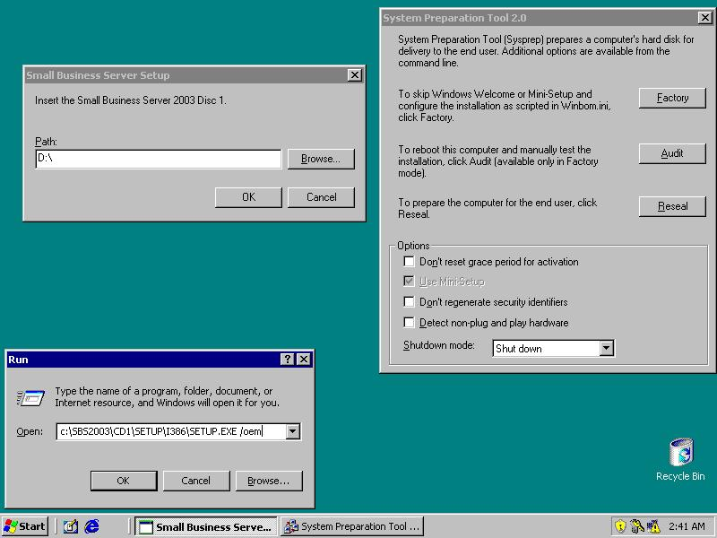
    Phase 2:
    Installing SBS components
1. Close this!!!
Don’t touch! ☺
2. Restart Setup in
OEM mode...

Slide 7
    Phase 3:
    Using sysprep to prepare the master image
Once the SBS installation has completed and the “To Do
List” is visible, Close the “To Do List” and the Sysprep
Dialog Box.
Open a command prompt Run sysprep by typing:
C:\Sysprep\sysprep.exe –dc –reseal
Using the -dc -reseal switches is absolutely
necessary. Sysprep will not run correctly without the
switches.
Sysprep must be run from a command prompt.
Don’t use the GUI dialog box to run it.
Notes:
Running Sysprep with the –dc and
–reseal switches does the following:
Clears registry keys that must be unique (for example, Microsoft Media Player, Internet connection settings, and items on the Start menu).
Resets the security IDs (SIDs) the next time the operating system starts and before either Windows Welcome or Mini-Setup is displayed.
Populates the mass storage section of the Sysprep.inf file and installs mass-storage drivers, if present.
Closes network connections.
Configures Windows Welcome or Mini-Setup to run the next time the computer boots.
Clears any system restore points.
Resets the time clock for Windows Product Activation.
The –dc switch enables Sysprep to run on a domain controller.

Slide 8
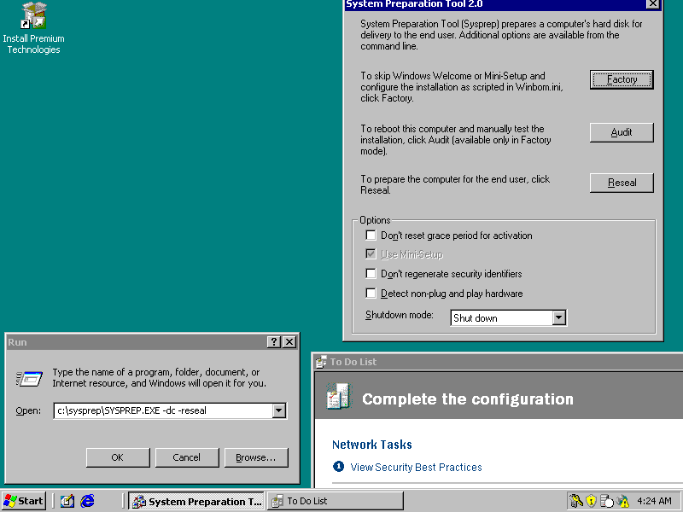
    Phase 3:
    Using sysprep to prepare the master image
2. Close this!
3. Run
sysprep –dc -reseal
1. Close this!
Notes:
Running Sysprep with the –dc and
–reseal switches does the following:
Clears registry keys that must be unique (for example, Microsoft Media Player, Internet connection settings, and items on the Start menu).
Resets the security IDs (SIDs) the next time the operating system starts and before either Windows Welcome or Mini-Setup is displayed.
Populates the mass storage section of the Sysprep.inf file and installs mass-storage drivers, if present.
Closes network connections.
Configures Windows Welcome or Mini-Setup to run the next time the computer boots.
Clears any system restore points.
Resets the time clock for Windows Product Activation.
The –dc switch enables Sysprep to run on a domain controller.

Slide 9


    Phase 4:
    Creating and using a master image
An image is based on the master computer preinstalled with SBS 2003 including all SBS applications
Use a third-party disk imaging application, hard drive disk duplicator or imagex to create and restore an image of Small Business Server 2003
Destination Computers must have the same hardware abstraction layer (HAL) as the master computer
Small Business Server 2003 is fully installed and configured
Run Sysprep – Reseal –DC and create an image
Reseller goes on-site to
manually perform
Mini Setup and
complete “To Do” List
OR
Deploy the SBS 2003 image to new Servers
Ship Server to customer site to complete Mini Setup and “To Do” list
Reminder: ISA and SQL included in SBS Premium need to be installed on-site.

Slide 10
  Let’s do it!

Slide 11
    DEMO
We will now start the live demo part and
  create the configuration set
  preload all the CD content to the HDD
  prepare the Windows PE 2005 image
  add drivers to the installation
  preload the necessary files for sysprep

Slide 12
  Key takeaways
  Create the configuration set
You need to use the OEM version of the Setup Manager
which is part of the OPK.
The OPK (SVR 2003 SP1) can be downloaded here:
http://oem.microsoft.com/script/ContentPage.aspx?pageid=561819
DON’T use the version in the deploy.cab on CD1 as you need to use the OEM version.

Slide 13
  Key takeaways preload all the CD content to the HDD
Create the following folder structure:
The files in the $1 folder will been on the
C: drive later
Place the files from the PREMIUM 1 & 2 CDs as highlighted on next page.
CD #5 contains the Outlook files.
$OEM$\$1\SBS2003
CD1
CD2
CD3
CD4
CD5
CD6
Premium

Slide 14
  Key takeaways preload all the CD content to the HDD part 2
1. Create a folder named Premium in the \SBS2003 folder
2. Copy the entire contents of Premium Technologies Disc 1 to \Premium
3. In the \Premium\SQL2005 folder create a subfolder named Servers.
(\Premium\SQL2005\Servers.)
4. Move all of the files and folders in the \Premium\SQL2005 folder into
the \Servers subfolder that you created in Step 3.
5. In the \Premium\SQL2005 folder, create a subfolder named Tools. For
(\Premium\SQL2005\Tools)
6. Copy the entire contents of the Premium Technologies Disc 2 folder,
d:\SQL2005, where d: is your CD drive, into the \Tools folder that you
created in Step 5.
7. Open the file \Premium\sitautorun.inf. Find the section, “[button3]”.
Under the [button3] section, find the key, “Action.” In the value for the
Action key, immediately following the word “execute,” change the path to
“SQL2005\Servers\Setup.exe…” leaving the rest of the value as is.

Slide 15
  Key takeaways
  Windows PE 2005
All tools are found on the OPK CD
1. Format an USB-Stick using formatUDF.exe
2. Create a folder \minint on the USB drive
3. Copy the content of \i386 from the OPK CD to \minint
4. Copy NTDETECT.COM from t\i386 to the root of the
USB drive
5. Copy \i386\setupldr.bin to \ntldr
This will create a file call “ntldr” on the root of the USB
drive.
6. Refer to the OPK.chm file in order to add drivers
Quick summary here: http://oem.microsoft.com/script/contentpage.aspx?pageid=554740
7. Copy the winbom.ini from configuration set to the root
of the USB drive

Slide 16
  Key takeaways
  Windows PE 2005
UNSUPPORTED (but working) way of adding storage drivers:
Edit the file TXTSETP.SIF (/minint/):
1.Place the PCI device IDs (found in the txtsetup.oem file) that you need
support for to the [HardwareIdsDatabase] section:
PCI\VEN_8086&DEV_282A&CC_0104 = "iastor"
PCI\VEN_8086&DEV_2822&CC_0104 = "iastor“
2.Add the .sys driver to the [SCSI.Load] section:
Iastore = iastor.sys,4

Slide 17
  Key takeaways
  Add drivers to the installation
Add storage driver
Edit the unattend.txt file found in the configuration set folder:
Add:
    [MassStorageDrivers]
    "Intel(R) ICH8R/ICH9R SATA RAID Controller" = "OEM"
    "Intel(R) 631xESB/632xESB SATA RAID Controller (Server/Workstation ESB2)" = "OEM"
    "IDE CD-ROM (ATAPI 1.2)/PCI IDE Controller" = "RETAIL"
    [OEMBootFiles]
    iastor.cat
    iastor.inf
    IaStor.sys
    TXTSETUP.OEM
    The first section contains all the “friendly names” you need support for out
    of the TXTSETUP.OEM File .
    The 2nd section must list all the needed files.
    Copy the driver files (from an F6-Floppy) to $OEM$\TEXTMODE.

Slide 18
  Key takeaways
  Add drivers to the installation
Add pnp-driver
Edit the unattend.txt file found in the configuration set folder:
In the [Unattended] section add:
OemPnPDriversPath = Drivers\LAN;Drivers\CHIPSET
    Copy the driver files to $OEM$\$1\Drivers\... (you need to create
    these folders)
$OEM$\$1\Drivers
LAN
CHIPSET

Slide 19
  Key takeaways preload the necessary files for sysprep
Copy all the files from the deploy.cab found on the CD1 of the SBS install CDs to $OEM$\$1\SYSPREP (you need to create this folder).
ALWAYS use the ones from the deploy.cab, this will make sure that you have the right versions.

Slide 20
  Key takeaways start the installation
Boot the target system using the USB drive.
-> WinPE will boot and connect to the network share
-> The installation will start
-> The system will reboot after the WinPE phase
Make sure that you removed the USB drive and connect
the system to a network without an DHCP server
-> The OS installation will continue
-> Once finished the SBS setup will start

Slide 21
  Key takeaways installation of the SBS components
Close the SBS setup and change the registry entries
that point to the install source.
Create the link for the premium components.
Restart the SBS setup in OEM mode.
Run: c:\sbsb2003\CD1\setup\i386\setup.exe /oem
Accept the default values.
The SBS setup is finished, when the “To Do List” is
displayed.

Slide 22
  Optional:
  Use Windows PE 2.0
  (Windows Vista based)

Slide 23
  Using WinPE 2.0
  Why?
You will only need one WinPE version for all
deployments, including Windows Vista, Windows XP,
Server 2003 etc.
Easy to add drivers and many drivers are already in the
image
Easy to boot from USB drives, Network (PXE & WDS)
and DVD/CD

Slide 24
  Using WinPE 2.0
  Prepare the Image
Get the Windows Vista OPK here:
https://oem.microsoft.com/script/contentpage.aspx?PageID=561189
After installing it open the “Windows PE Tools Command Prompt”
Type copype x86 c:\winpe-x86 to create a WinPE x86 working directory.
Go to the directory c:\winpe-x86 and type:
mkdir working
imagex /apply winpe.wim 1 working
Copy Imagex and bootsect.exe to the image:
mkdir c:\winpe-x86\working\tools
xcopy “c:\Program Files\Windows OPK\Tools\x86\*.*”
c:\winpe-x86\working\tools /cherky
copy “c:\Program Files\Windows OPK\Tools\PETools\x86\BootSect.exe”
c:\winpe-x86\working\tools
Add drivers (LAN or storage) using peimg /inf
Capture the new image:
imagex /boot /compress max /capture c:\winpe-x86\working c:\winpe-x86 \
boot.wim “WinPE x86”

Slide 25
  Using WinPE 2.0
  Boot the image
There are two highly suggested ways of booting the new WinPE image to install the SBS 2003 Server or any other Windows OS:
  WDS (PXE)
  -> Just add the new image to the WDS boot images
  USB HDD
  -> Refer to the “Windows PE User’s Guide” for an easy how to
The installation sources can be placed on the USB HDD as well, so that no network share is needed.

Slide 26
  Using WinPE 2.0
  Prepare the SBS 2003 files
Create a directory “SBS2003” on the share or the USB HDD
Copy the complete i386 directory from CD1 to just created SBS2003 directory
Copy the complete $OEM$ directory created in earlier steps to the
i386 directory
Copy the unattend.txt file to the SBS2003 directory
Create the following scripts (need to be adjusted to your directory names, in this example z: is the name of the share or USB drive) and place them in the SBS2003 directory:
Unattend.bat:
diskpart /s z:\SBS2003\diskprep.txt
format c: /fs:ntfs /q /v:SBS2003OS /y
x:\tools\bootsect.exe /NT52 C:
set AnswerFile=z:\SBS2003\unattend.txt
set SetupFiles=z:\SBS2003\I386
z:\SBS2003\I386\winnt32 /s:%SetupFiles% /unattend:%AnswerFile% /syspart:c:
wpeutil reboot
diskprep.txt:
sel dis 0
clean
cre par prim
active
assign letter=c

Slide 27
  Using WinPE 2.0
  Directory structure
\SBS2003
\i386
\$OEM$
\$1
\SBS2003\
CD1
\sysprep
\Drivers
CD2
CD3
CD4
unattend.bat
CD5
\TEXTMODE
CD6
diskprep.txt
Premium
\$$
unattend.txt
\$Progs

Slide 28
  Using WinPE 2.0
  Start the installation
WDS:
  Boot the target server using PXE boot
  Connect to the share with the SBS2003 files
  Start the installation by executing unattend.bat
USB HDD:
  Boot the target server using the USB HDD
  Chang to the SBS2003 directory on the USB HDD
  Start the installation by executing unattend.bat

Slide 29
  Using WinPE 2.0
  Capture/apply an
  SBS 2003 image using imagex
Capture:
Boot WinPE using WDS or an USB HDD
Type imagex /capture c: z:\sbsimages\server.wim “Superserver 1000”
(z: is the share or letter of the USB HDD)
Apply:
Prepare the disk using diskpart and the scrip used for installation:
diskpart /s diskprep.txt
Format the drive.
Apply the nt52 bootsector to the drive:
x:\tools\bootsect.exe /NT52 C:
Apply the image:
imagex /apply z:\sbsimages\server.wim 1 c:

Slide 30
  Questions?
  Comments?

Slide 31
  Web resources
Microsoft OEM Partner Center
http://oem.microsoft.com
Guide to preinstalling Windows Small Business Server 2003 using the OPK on new computers for distribution to end users
https://oem.microsoft.com/downloads/worldwide/OPK_RC/SBSOEMPreinstall_ed.pdf
OPK WinPE (2005)
https://oem.microsoft.com/script/contentpage.aspx?pageid=555487
Microsoft OEM Preinstallation Kit (OPKs) downloads
https://oem.microsoft.com/script/ContentPage.aspx?pageid=557631
HOW TO: Create an Unattended Installation of Third-Party Mass Storage Drivers in Windows Server 2003
http://support.microsoft.com/kb/816299
Get the Windows Vista OPK here:
https://oem.microsoft.com/script/contentpage.aspx?PageID=561189
Support e.mail: sbst@microsoft.com

